Slide 1
Bot Trader
28-09-2023
Sivaprasad

Slide 2
Problem Statement
"Developing an Automated Trading Bot Using Historical Market Data"

Slide 3
Objectives
Market Based Approach - In market approach we directly find the returns from the close price of the historical trade data and using its sharpe ratio we initiate trade
Trade Based Approach - In Trade approach we use the historical trade data and apply Reinforcement Learning (A2C) and the model will predict the net worth.
From the net worth we compute the returns and calculate the sharpe ratio to initiate trade

Slide 4
Architecture diagram
Web application front end
REST API
Trading bot
Order management using market data as well as trade data (paper trading)
For Market data and trade data:
If sharpe ratio>0.4 buy action,
If reward < 0.02 of previous reward selling action
Data fetching API
Trading algorithm
(A2C)
Deep Reinforcement Learning algorithms for model training and returns calculations
To fetch historical trading data we can use Alpaca API or Yahoo finance api

Slide 5
Market Based Approach

Slide 6
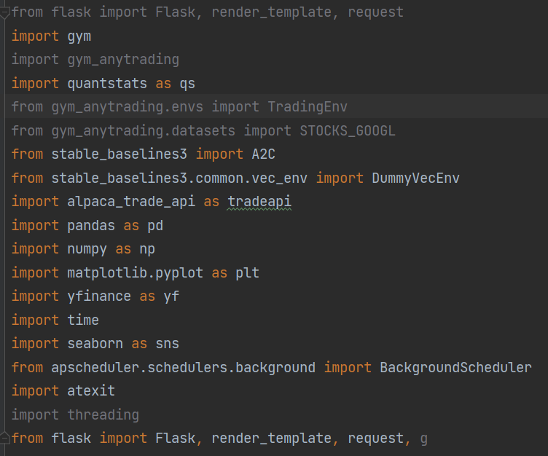
Importing Libraries
QuantStats is a Python library designed for quantitative finance and investment analysis
It is used by individual traders, quantitative analysts, and algorithmic trading firms to build and execute trading strategies in the financial markets
Fig: Screenshot of the Imported libraries

Slide 7
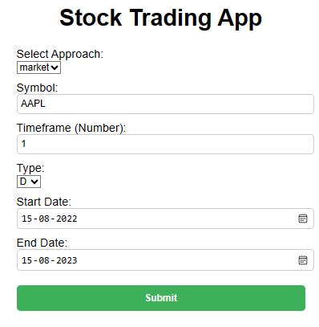
Getting the parameters from the user
Fig: Screenshot of the UI after selecting the parameters

Slide 8
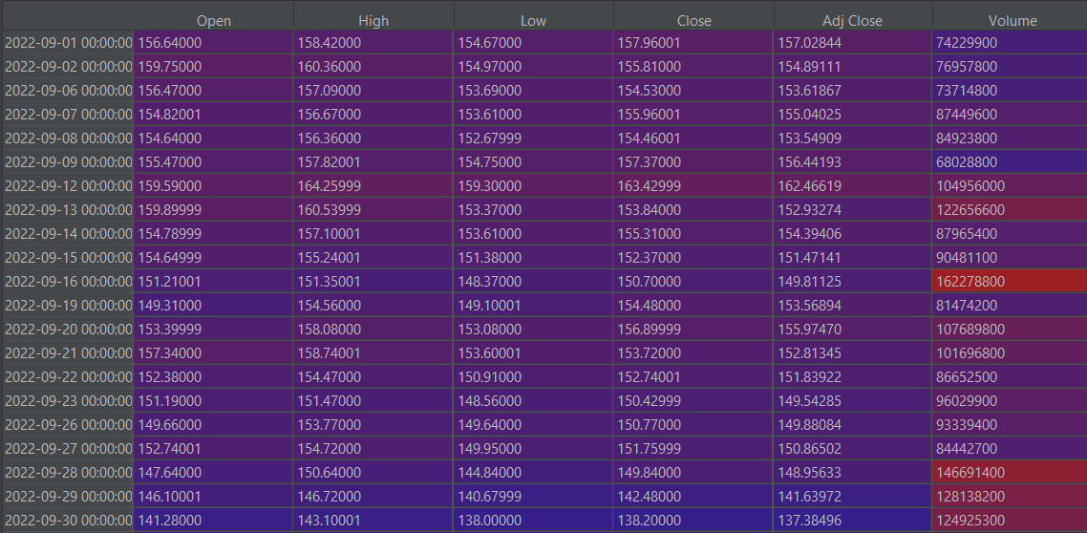
Fetching the data from the API
Fig: Screenshot of Data

Slide 9
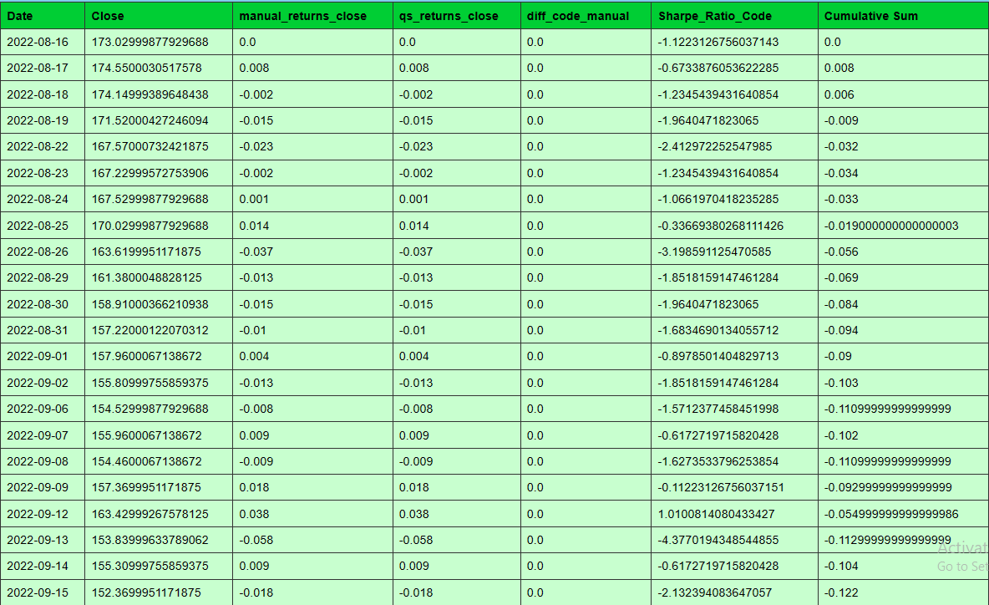
Capturing The Key Factors
Fig: Screenshot of the UI Output

Slide 10
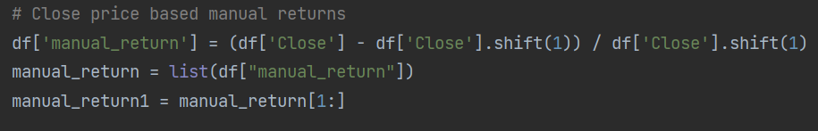

Calculating Returns
Programmatically
Using Library

Slide 11
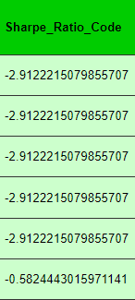

Sharpe Ratio
Sharpe Ratio (S) = (Rp - Rf) / σp
Where:
S is the Sharpe Ratio.
Rp is the average return of the investment.
Rf is the risk-free rate of return (usually a government bond yield or similar).
σp is the standard deviation of the returns.
Programmatically
Using Library we find the average sharpe ratio Using close price

Slide 12

Cumulative Sum Of Returns

Slide 13
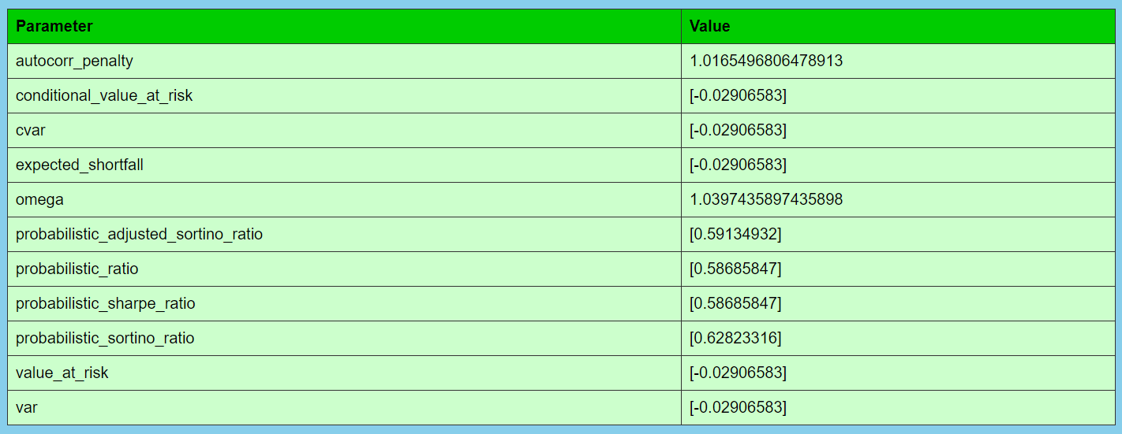
Parameter Displaying

Slide 14
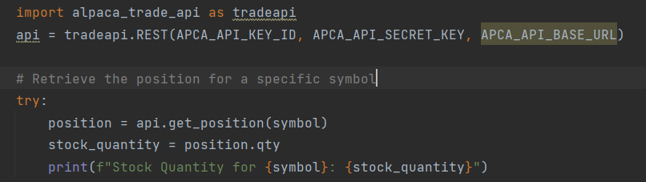
Getting positions from alpaca
Retrieves the position for a given symbol and retrieves the quantity of stocks

Slide 15
Placing Buy And Sell Order
Buy order Conditions -
If stock quantity is 0
Length is 81 or above (Here it is taken for experimental purpose, We can take 252 days as it is total trading days in a year)
Sharpe ratio is above 0.1 (Here it is taken for experimental purpose)
Last action should be sell or none

Slide 16
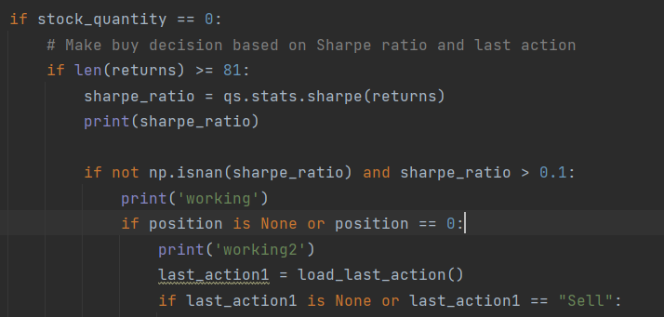
Buy order Conditions -
Fig: Screenshot of the code which satisfies buying condition

Slide 17
Sell order Conditions -
If stock quantity is above 0
Length is 81 or above (Here it is taken for experimental purpose, We can take 252 days as it is total trading days in a year)
If there is a 2% dip in the last return from the previous return (Here it is taken for experimental purpose)
Last action should be Buy

Slide 18
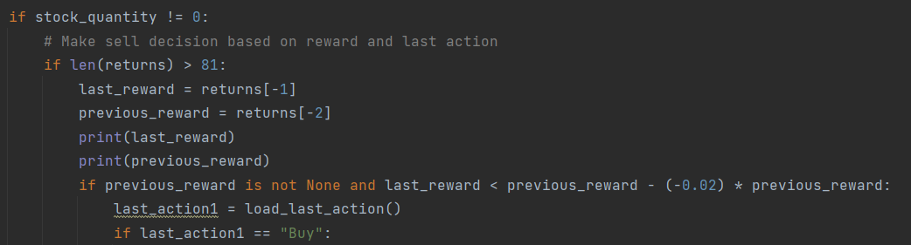
Sell order Conditions -

Slide 19
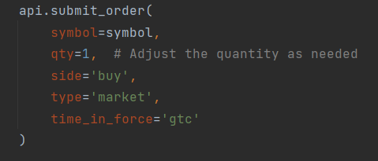
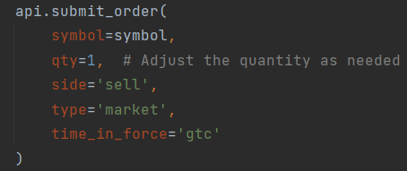
Submitting Buy or Sell
Buy :
Sell :

Slide 20
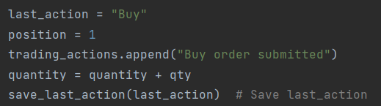
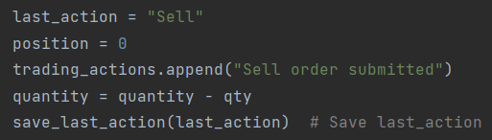
After every Buy or Sell order
Last action will get saved by buy
Position set to 1
Quantity will be added
Buy :
Last action will get saved by sell
Position set to 0
Quantity will be subtracted
Sell :

Slide 21
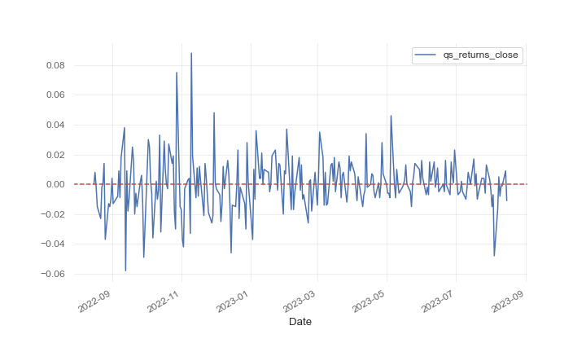
Plotting graph on market based approach
Start_date=2022-08-15 End_date= 2023-08-15
Daily returns plot
Cumulative return: 0.062

Slide 22
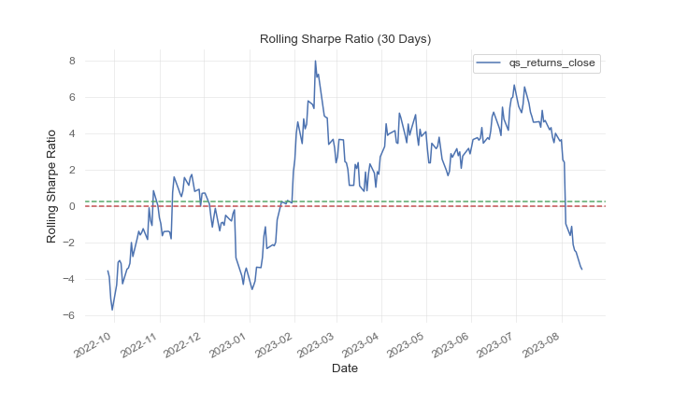
Plotting graph on market based approach
Start_date=2022-08-15 End_date= 2023-08-15
Cumulative return: 0.062

Slide 23
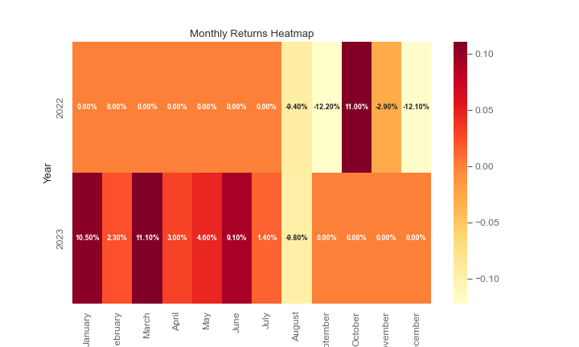
Plotting graph on market based approach
Start_date=2022-08-15 End_date= 2023-08-15
Cumulative return: 0.062

Slide 24
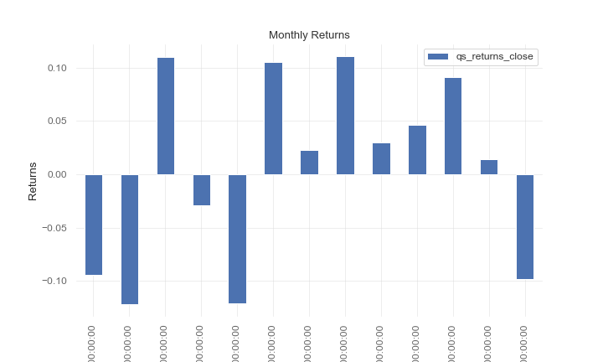
Plotting graph on market based approach
Start_date=2022-08-15 End_date= 2023-08-15
Cumulative return: 0.062

Slide 25
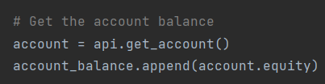
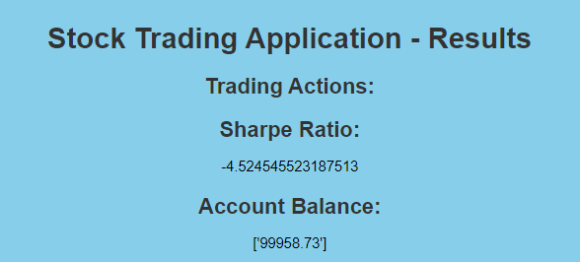
Get account balance from alpaca

Slide 26
Trade Based Approach

Slide 27
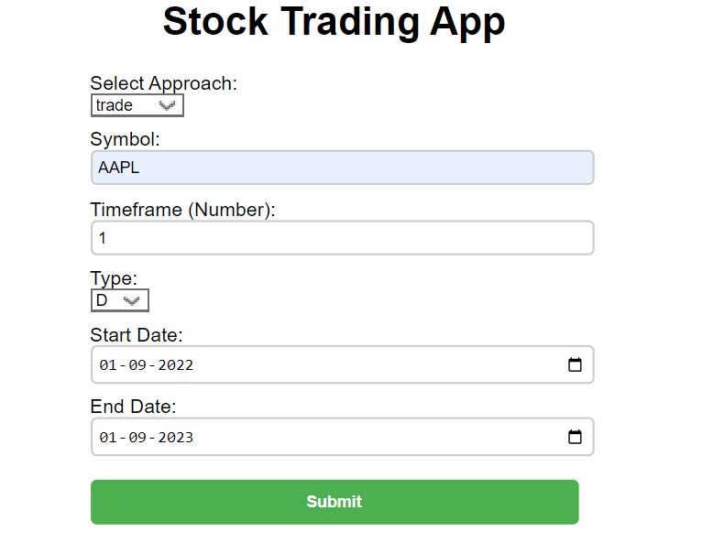
Getting the parameters from the user
Fig: Screenshot of the UI after selecting the parameters

Slide 28
Fetching the data from the API
Fig: Screenshot of Data

Slide 29
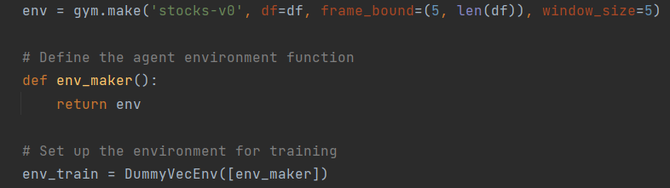
Creating and setting up Gym environment
Gym refers to the OpenAI Gym library
It provides a collection of pre-defined environments for RL tasks
Gym anytrade provides an interface for custom trading environments with historical price data, allowing you to define trading rules, actions, and rewards

Slide 30
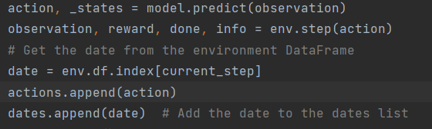

Applying the A2C (Advantage Actor-Critic) RL algorithm
The data fetched is now trained by the model
It uses an MLP (Multi-Layer Perceptron) policy
The model predicts an action based on the current observation.
The action is applied to the environment, resulting in a reward and updated observation.
The date corresponding to the current step is recorded.
The model also gives us the Total Profit

Slide 31
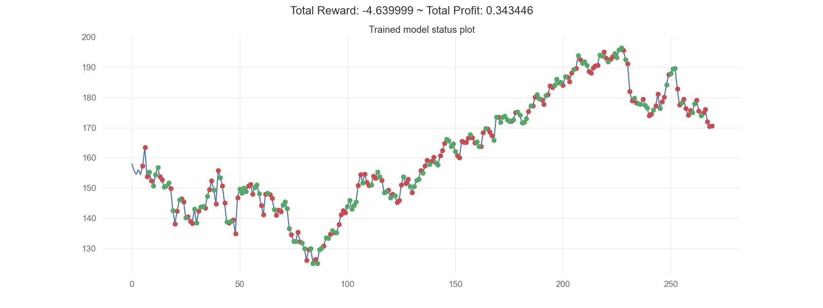
Plotting of Action graph
The code generates a plot to visualize the model's performance.
The plot displays the trading status of the trained model over the historical data.

Slide 32
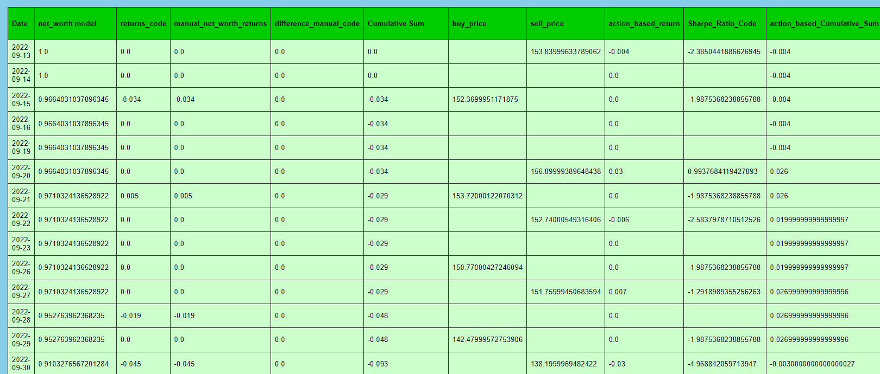
Capturing The Key Factors
Fig: Screenshot of the UI Output

Slide 33
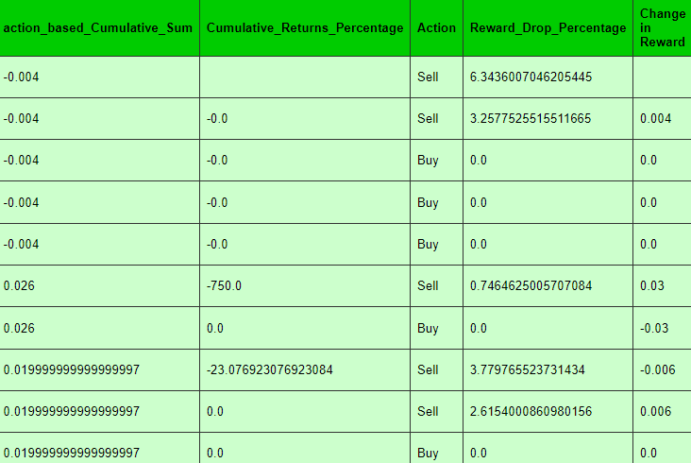
Capturing The Key Factors
Fig: Screenshot of the UI Output

Slide 34
Calculating Net worth
The Net worth is computed as a Pandas Series . It represents the cumulative profit over time and it is taken from the Total profit which is given by the model

Slide 35
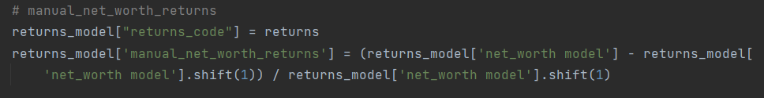
Calculating Returns From Net Worth
Programmatically
Using Library we pass the networth to obtain the returns

Slide 36
Cumulative Sum Of Returns from Net worth

Slide 37
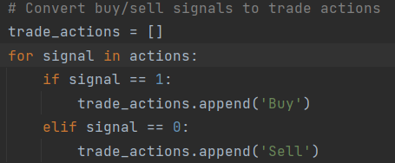
Converting signals given by the model to Trade actions
We are converting the actions given by the model(1/0) into human-readable trade actions(Buy/Sell)

Slide 38
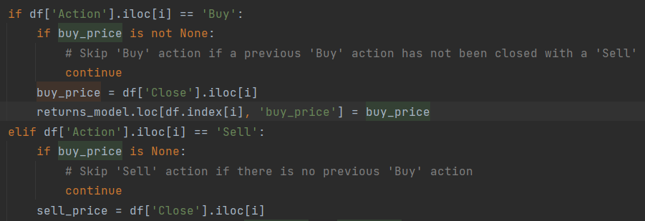
Listing out Buy price and Sell price
Recording the close value while Buy and Sell actions happened and adding it to the data frame

Slide 39
Calculating The Trade return based on Actions (Buy/Sell)
Recording the close value while Buy and Sell actions happened and adding it to the data frame
Finding the return ratio with sell price and buy price

Slide 40
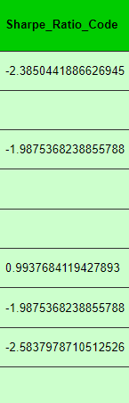


Sharpe Ratio
Sharpe Ratio (S) = (Rp - Rf) / σp
Where:
S is the Sharpe Ratio.
Rp is the average return of the investment.
Rf is the risk-free rate of return (usually a government bond yield or similar).
σp is the standard deviation of the returns.
Programmatically
Using Library we find the average sharpe ratio Using close price

Slide 41
Calculating The Cumulative sum of return from actions
Calculating The Percentage change of action based cumulative sum

Slide 42

Displaying the actions occurred as per the model

Slide 43
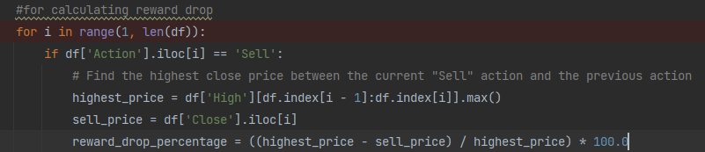
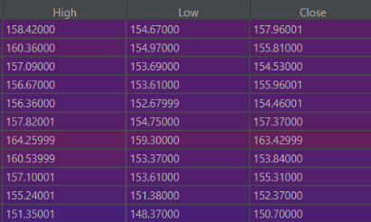
Calculating The Reward Drop from actions
Calculating the "Reward Drop Percentage" when a 'Sell' action is encountered
Finds highest price and close price between the current 'Sell' action and the previous action

Slide 44
Displaying the actions occurred as per the model
Change in Reward' column helps track the changes in returns from one time step to the next
We find it using diff function

Slide 45
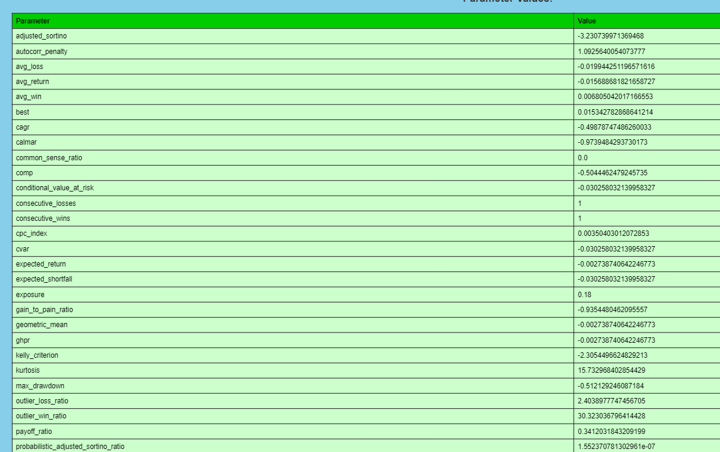
Parameter Displaying

Slide 46
Getting positions from alpaca
Retrieves the position for a given symbol and retrieves the quantity of stocks

Slide 47
Placing Buy And Sell Order
Buy order Conditions -
If stock quantity is 0
Length is 81 or above (Here it is taken for experimental purpose, We can take 252 days as it is total trading days in a year)
Sharpe ratio calculated using net worth returns is above 0.1 (Here it is taken for experimental purpose)
Last action should be sell or none

Slide 48
Buy order Conditions -
Fig: Screenshot of the code which satisfies buying condition

Slide 49
Sell order Conditions -
If stock quantity is above 0
Length is 81 or above (Here it is taken for experimental purpose, We can take 252 days as it is total trading days in a year)
If there is a 2% dip in the last net worth returns from the previous net worth return (Here it is taken for experimental purpose)
Last action should be Buy

Slide 50
Sell order Conditions -
When there is a 2% dip

Slide 51
Submitting Buy or Sell order
Buy :
Sell :

Slide 52
After every Buy or Sell order
Last action will get saved by buy
Position set to 1
Quantity will be added
Buy :
Last action will get saved by sell
Position set to 0
Quantity will be subtracted
Sell :

Slide 53
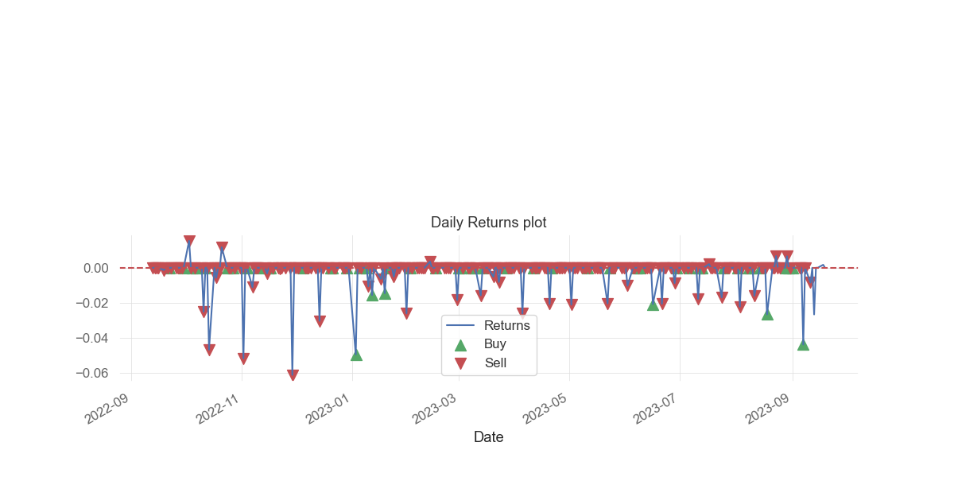
Plotting graph on market based approach
Start_date=2022-08-15 End_date= 2023-08-15
Cumulative return: 0.062

Slide 54
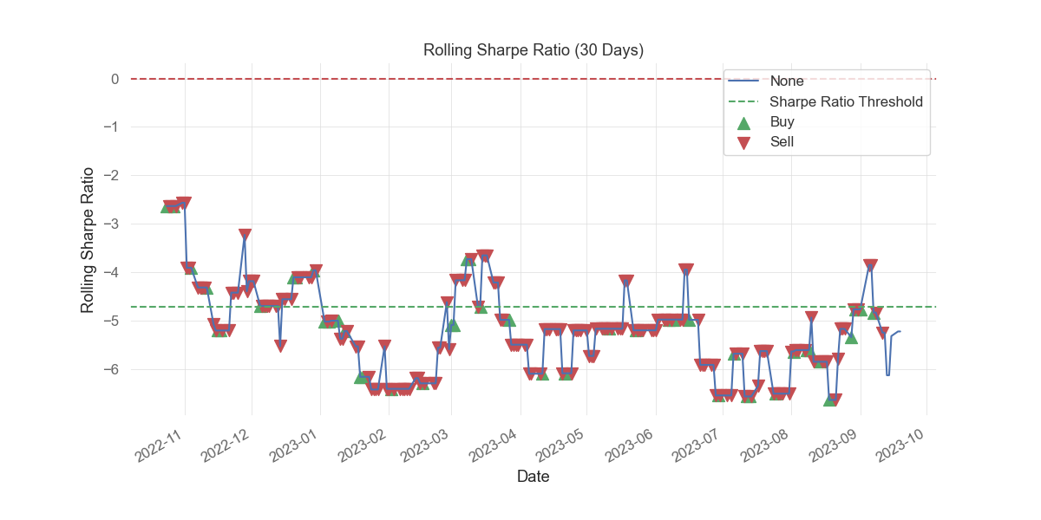
Plotting graph on market based approach
Start_date=2022-08-15 End_date= 2023-08-15
Cumulative return: 0.062

Slide 55
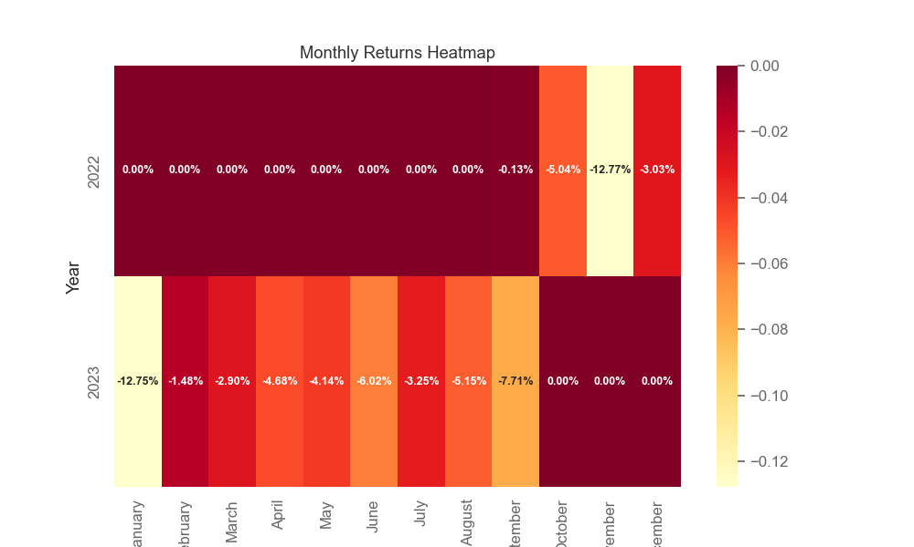
Plotting graph on market based approach
Start_date=2022-08-15 End_date= 2023-08-15
Cumulative return: 0.062

Slide 56
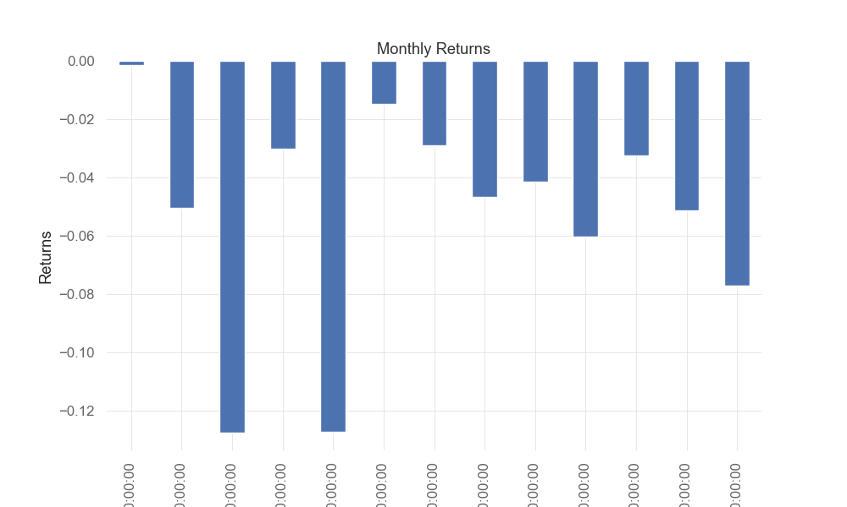
Plotting graph on market based approach
Start_date=2022-08-15 End_date= 2023-08-15
Cumulative return: 0.062

Slide 57
Get account balance from alpaca

Slide 58
Thank you

